Slide 1
Overcoming Braess‘s Paradox: A Learning/Model Based Approach
Complex Social Systems: Agent Based Modelling
HS 22
Nikhil Sethukumar
Vishnu Varadan

Slide 2
Agenda
Motivation/ What is Braess‘s Paradox
A Small Refresher on Game Theory
The Game
The Centralized Scheduler
How to get rid of the Central Scheduler ? / Distributed approach
Can the agents be made more intelligent ?
Conclusion and Outlook

Slide 3
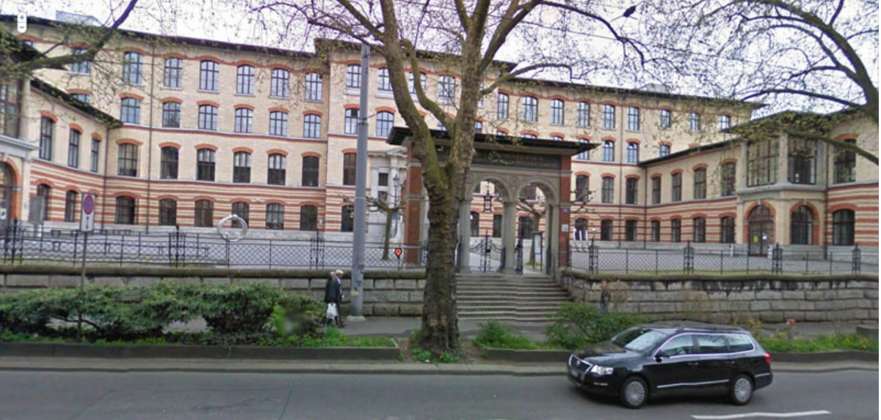



What is Braess‘s Paradox ? A Relatable Example
Image Source : http://www.vs.inf.ethz.ch/contact/CNBmap.html,

Slide 4
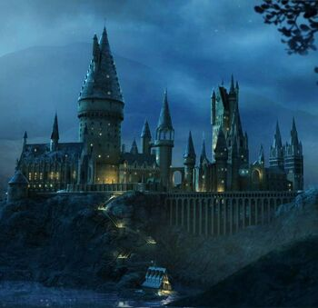
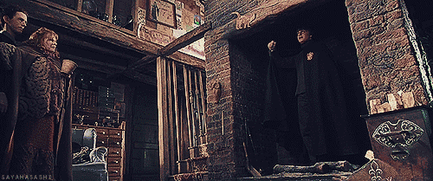
What is Braess‘s Paradox ? A Relatable Example
Image Source: https://harrypotter.fandom.com/wiki/Hogwarts_Castle
Image Source: https://chlohemian.com/2017/02/11/greece-land-of-moussaka-and-typos/harry-potter-floo-powder-gif/

Slide 5
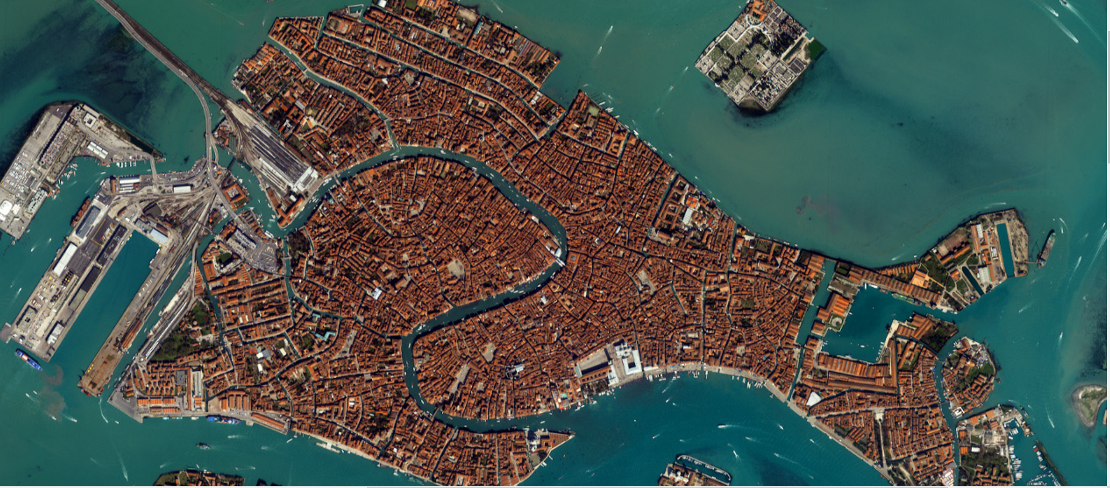
What is Braess’s Paradox ? A real-world example
Image Source: https://eoimages.gsfc.nasa.gov/images/imagerecords/4000/4582/venice_iko_2001092_lrg.jpg

Slide 6
A quick refresher on Game Theory
The players are the agents that make decisions
Actions are the finite or infinite set of decisions that the players can take
The objective specifies the goal of each player. The objectives are often associated with costs that the agents incur due to their actions and the actions of other players
A set of actions is called the Nash Equilibrium if no player can do better by unilaterally changing their action
The social cost is an indicator of the general well-being among all the agents
The Price of Anarchy is a measure of how worse the NE solution is when compared to all possible action sets available to the agents
Hespanha, João P. Noncooperative Game Theory: An Introduction for Engineers and Computer Scientists. Princeton University Press, 2017. JSTOR, https://doi.org/10.2307/j.ctt1vwmgbh. Accessed 10 Dec. 2022.
Saverio Bolognani, Lecture Slides of Game Theory and Control , ETH Zurich FS22

Slide 7
A quick refresher on Game Theory Braess‘s Paradox in Numbers
 | CAB to HG with Floo Powder | CAB to HG without Floo Powder
Players | 200 players | 200 players
Actions | {CAB-ML-HG,CAB-LFW HG,CAB-ML-LFW-HG, CAB-LFW-ML-HG} | {CAB-ML-HG,CAB-LFW-HG}
Costs | {55+0.1n,55+0.1n,30+0.1n+0.1n,80} | {55+0.1n,55+0.1n}
Nash Equilibrium | All agents choose CAB-ML-LFW-HG with a cost of 70 per agent | 100 agents choose CAB-ML-HG while another 100 choose CAB-LFW-HG with a cost of 65 per agent
Social Cost
Price of Anarchy | 108.7% | 1
FLOO POWDER MADE THE TRAFFIC WORSE?!

Slide 8
A quick refresher on Game Theory Braess‘s Paradox in Numbers
 | Venice !
Players
Actions
Costs
Nash Equilibrium
Social Cost
Price of Anarchy
BRIDGE MADE THE TRAFFIC WORSE?!

Slide 9
The Game
Use https://csacademy.com/app/graph_editor/ to draw a graph and explain the parameters of our graph
Important to add multi-stage game

Slide 10
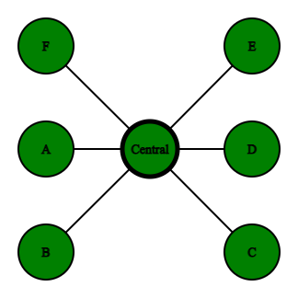
The Centralized Scheduler
What is the function of the centralized scheduler?
The centralized scheduler monitors the stage cost of each agent
After the end of each stage of the game, the scheduler reorders the agents
Providing an advantage to the agents that incurred a high cost during the previous stage of the game by giving preference to that agent in selecting an actions
Agents
Scheduler

Slide 11
The Centralized Scheduler
Drawbacks of a centralized scheduler
Why is it not desirable ?

Slide 12
How to get rid of the Central Scheduler ?
An agent model that takes into account the selfishness factor and that decides the number of neighbours it chooses to interact with. How do we model the agent ?
What are the updated parameters of the game ?
What are the advantages ? How does it overcome the disadvantages of the centralized scheduler?

Slide 13
How to get rid of the Central Scheduler ?
Results using the distributed method:
What does the action converge to ?
Average per player per stage cost
Average per player cost
How do the results vary with different initializations?
Is this an ‘equilibrium’ ?

Slide 14
Can the agents be made more intelligent ?
Yessss Nikhil is on it !

Slide 15
Conclusion and Outlook
How can this be implemented practically ?
How bad is selfish routing ?
What can be done further up to get rid of this ‘paradox’ ?

